Slide 1
Pokerbots 2022
Lecture 2: Poker Theory

Slide 2











Sponsored by multiple top quantitative finance firms, Pokerbots is also a great opportunity for networking and landing jobs or internships!
pkr.bot/drop
Notes:
Shreyas
---
imc=silver
sig=gold
hrt=platinum
Jane st = gold
Citadel = gold
Optiver = plat
Drw = gold or plat fornow put gold

Slide 3
Resume Drop

Slide 4
Drop Resume:
pkr.bot/drop

Slide 5
Giveaway

Slide 6
Giveaway Game:
pkr.bot/steps

Slide 7
Find Teammates!
Piazza post @5

Slide 8
Logistics

Slide 9
Intro to Programming!
Piazza post @7

Slide 10
Scrimmage Server:
Piazza Post @24

Slide 11
Link:
scrimmage.pokerbots.org

Slide 12
Week 1 bot deadline:
Saturday Jan 8, 11:59 p.m EST

Slide 13
Agenda
Hand types
Pot odds
Implied odds
Ranges
Variant strategic considerations
Coding reference-lecture-2 bot

Slide 14
Hand types

Slide 15
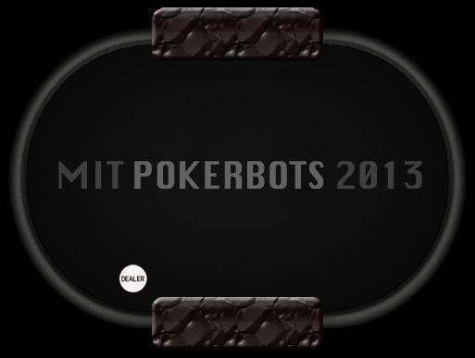







Drawing hand

Slide 16
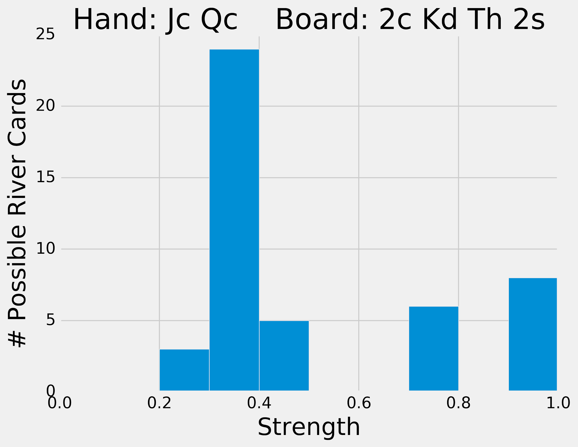
Drawing hand

Slide 17


Low pair

Slide 18
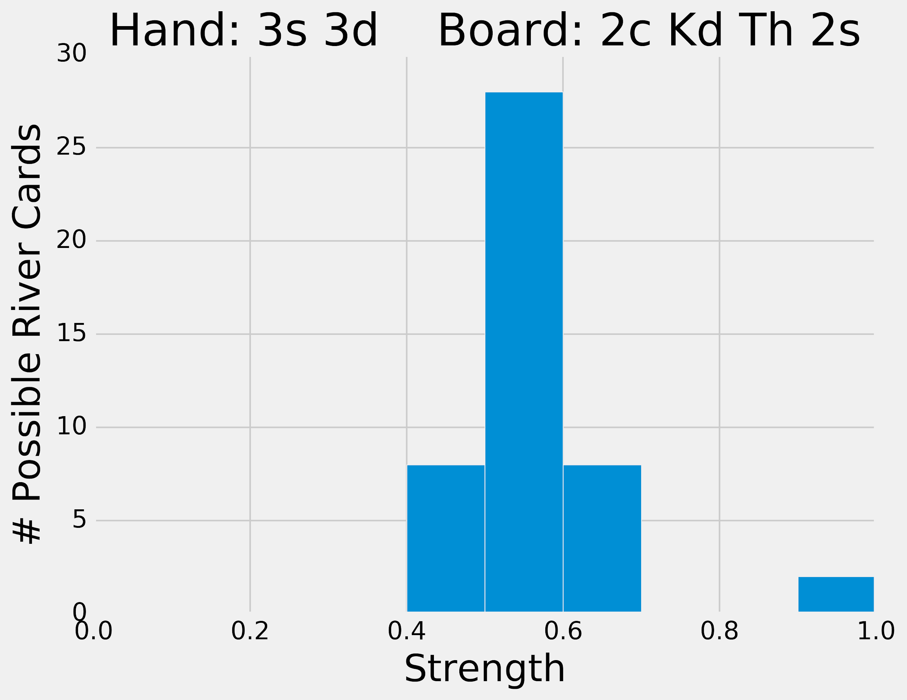
Low pair

Slide 19


Made hand

Slide 20
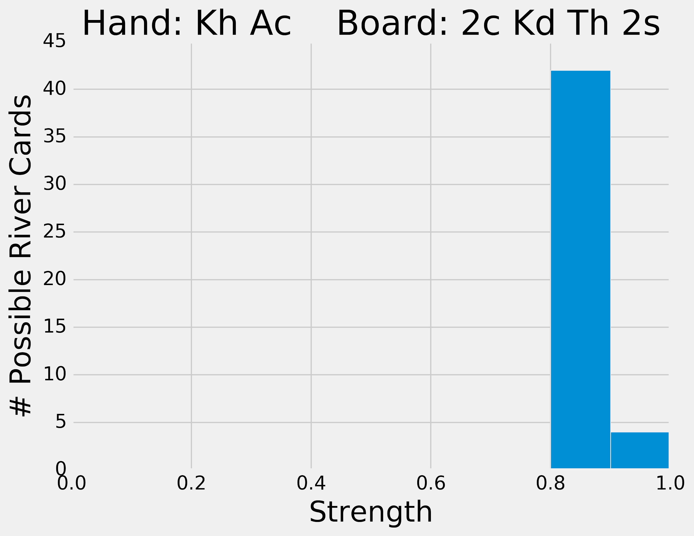
Made hand

Slide 21


“The nuts”

Slide 22
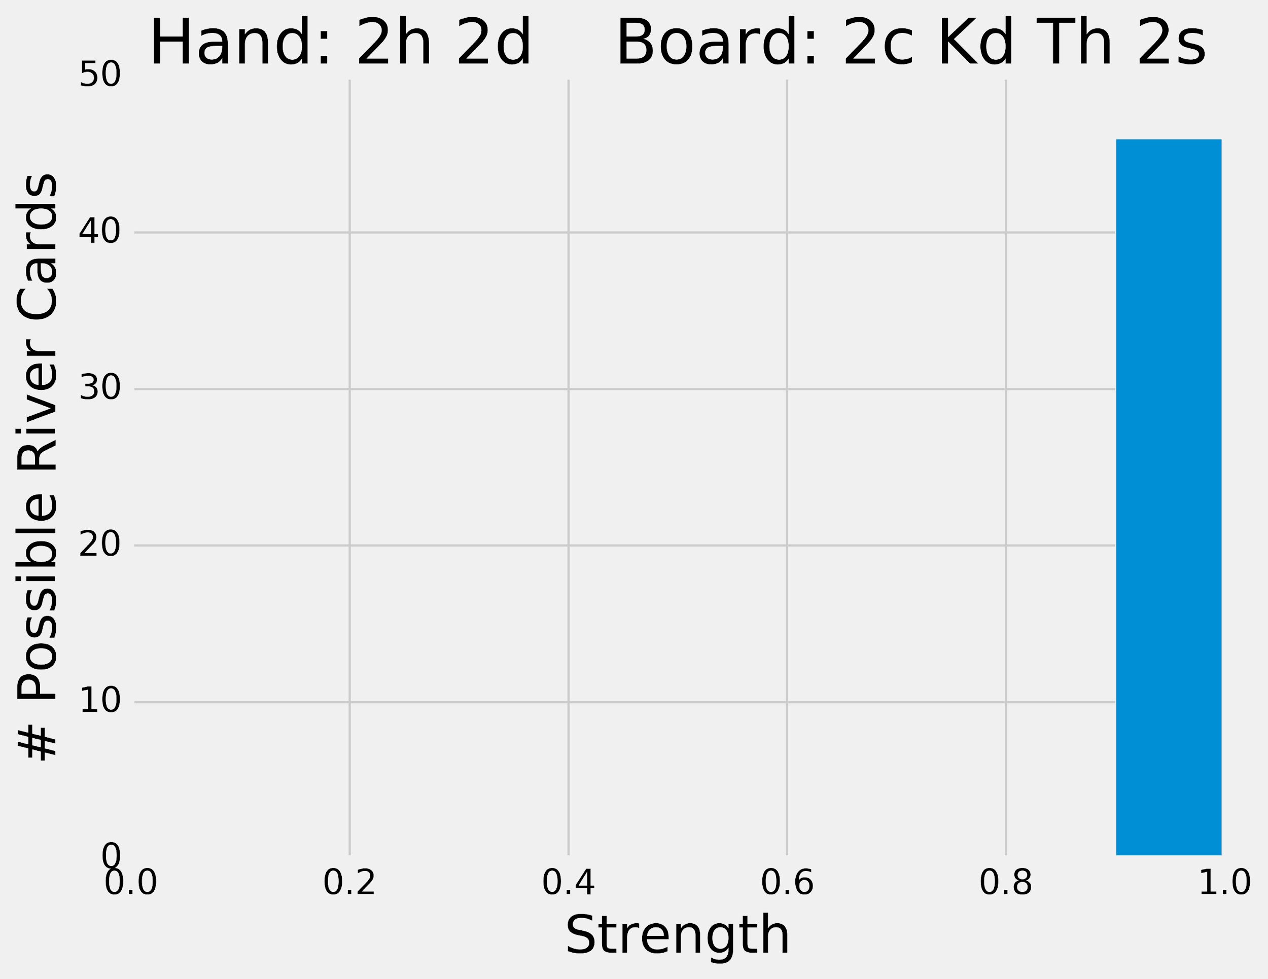
“The nuts”

Slide 23
Board types

Slide 24


How would you feel about your hand strength here?

Slide 25




What about here?

Slide 26
Pot Odds & Outs

Slide 27
Pot odds
Claim: for any state of the game, there exists some probability p of winning
This depends on our opponent’s strategy, but let’s ignore that for now
0 ≤ p ≤ 1

Slide 28
Calculate expected value
p · pot_total − (1 − p) · continue_cost
>0?
=0?
<0?

Slide 29
Separate p
Cutoff: we should stay in the game if
p ≥ continue_cost / (pot_total + continue_cost)
Right-hand side is called the pot odds

Slide 30

Exercise
40
40
Notes:
Here we’ve reached a game state where both players have contributed 40 chips to the pot thus far

Slide 31
Exercise
50?
40
Notes:
Our opponent raises his bet by 10 chips. The question now becomes “do we call their raise?”.

Slide 32
Example pot odds
pot_total = 90
continue_cost = 10
pot odds = 10 / (90 + 10) = 0.1
If p ≥ 0.1, we should call!
How do we know what p is?
Notes:
We use pot odds to answer that

Slide 33
Counting outs
Idea: If we know which cards we need to complete our hand, we can estimate the probability of getting those cards. If our hand is strong, this estimates our probability of winning the game (p)!
Strategy:
Count the number of cards that complete our hand (outs)
Multiply this number by 2 (52 cards gives ~2% chance of getting a specific card)
If we have two cards left to see, multiply by 2
This number is our probability estimate! (as a percent)

Slide 34
Exercise
50?
40

Slide 35
Calculating p
outs = 8
probability of completing the hand is 8 * 2 = 16%
p = 0.16
pot odds = 0.1
p is greater than our pot odds - we should call!
Notes:
We use pot odds to answer that

Slide 36
Reverse pot odds
If we overbet relative to the size of the pot, then we give our opponent the opportunity to exploit pot odds
If they have a bad hand, we win a little
If they have “the nuts,” we lose a lot

Slide 37
Example: the all-in bot
Our opponent goes all-in on the preflop (deterministic!)
We can check-fold, letting our opponent collect the blinds, until we are dealt a high pair to crush them and win big

Slide 38
Implied and Reverse Implied Odds

Slide 39
Implied Odds
The amount of money you expect to win on later streets if you hit one of your outs
Enables us to call when we don't have the right pot odds
Mostly important when calling with a drawing hand

Slide 40
Updated p
Pot odds cutoff: we should stay in the game if
p ≥ continue_cost / (pot_total + continue_cost)
Implied odds cutoff: we should stay in the game if
p ≥ continue_cost / (pot_total + continue_cost+ amount_you_expect_to_win)
Sometimes you need to factor in calling multiple streets

Slide 41
Exercise
40
40
Notes:
Here we’ve reached a game state where both players have contributed 40 chips to the pot thus far

Slide 42
Exercise
60?
40

Slide 43
Pot odds revisited
pot_total = 100
continue_cost = 20
pot odds = 20 / (100 + 20) = 0.167
From counting outs, p = 0.16
Pot odds tell us to fold!
Notes:
We use pot odds to answer that

Slide 44
Implied Odds
Assumption: our opponent been always betting, and will continue to bet ¼ pot
pot_total = 100, continue_cost = 20, next_bet = ¼ * (120) = 30
pot odds = 20 / (100 + 20 + 30) = 0.133
From counting outs, p = 0.16
Implied odds tell us to call!
Notes:
We use pot odds to answer that

Slide 45
Reverse Implied Odds
This is the amount you could expect to lose after hitting your draw
Balances out implied odds, and together they provide a better estimate of your true pot odds
Warns us to be careful when we're not drawing to "the nuts"
Notes:
We use pot odds to answer that

Slide 46
Exercise
40
40
Notes:
Here we’ve reached a game state where both players have contributed 40 chips to the pot thus far

Slide 47
Exercise
60?
40

Slide 48
Exercise
60
60
Notes:
Here we’ve reached a game state where both players have contributed 40 chips to the pot thus far

Slide 49
Exercise
60
60
Notes:
Here we’ve reached a game state where both players have contributed 40 chips to the pot thus far

Slide 50
Exercise
90?
60
Notes:
Here we’ve reached a game state where both players have contributed 40 chips to the pot thus far

Slide 51
Exercise
90
90
Notes:
Here we’ve reached a game state where both players have contributed 40 chips to the pot thus far

Slide 52
Exercise
90
90
Notes:
Here we’ve reached a game state where both players have contributed 40 chips to the pot thus far

Slide 53
Ranges

Slide 54
Ranges
We know the pot odds when faced with any bet
If we can estimate p better than our opponent, then we will make money on average
What affects p?

Slide 55
Factors of win probability
Bluffing
Betting style
Board and Hole cards
Ranges

Slide 56
Our opponent’s range is the distribution of hands we expect them to hold

Slide 57
Range Exercise
40
40
Notes:
Here we’ve reached a game state where both players have contributed 40 chips to the pot thus far

Slide 58
Updating Ranges
Use opponents actions to narrow range
"Everything conveys information"
How do your cards compare to their range?
What about your range?

Slide 59
Which ranges are good?
Tight-aggressive
Fold early and often to mitigate losses
Bet and win when you have a good hand!

Slide 60
Variant strategic considerations

Slide 61
Swap Hold’em
About 50% chance at least 1 card is swapped
Preflop action should still be the same, postflop action consider updating ranges
Remember cards in your hands are "blockers"
If bots are betting randomly, remember reverse pot odds and wait for a good time to trap them

Slide 62
Coding reference-lecture-2 bot

Slide 63
Goals
Improve our betting strategy
Implement pot odds
Incorporate randomness
Monte Carlo simulation for card strength estimation (p)

Slide 64
Monte Carlo Simulation
Helps us estimate values by using randomness and sampling
Simulates a process many times to see what happens on average
We can estimate our hand strength by simulating poker games many times
The proportion of wins from the simulations is our win probability!

Slide 65
Giveaway Winner

Slide 66
Step Count:
7300.5

